Slide 1
Rehabilitation Research, Development and Translation Centers
October 2024

Slide 2
Collectively Centers Address Rehabilitation Needs to Improve Function and Independence: Disabling Conditions, Populations, Interventions
Hearing Loss
Tinnitus
Vestibular Dysfunction
Vision Loss
Traumatic Brain Injury
PTSD/Stress Disorders
Behavioral Health/Mental Health/Brain Health Conditions
Homelessness/Integration
Needs of Women Veterans
Pain
Limb Loss
Musculoskeletal Disorders
Traditional & Neural Prosthetics
Brain Computer Interface/Brain Machine Interface
Wheeled Mobility
Robotics
Electrical stimulation
Spinal Cord Injury/Disorder
Neurological Conditions
Suicide

Slide 3
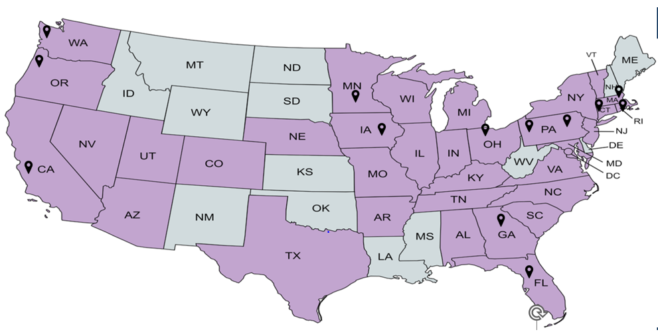
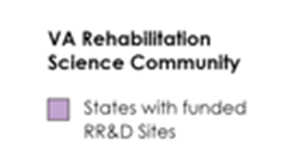

VA Rehabilitation Science Community
Seattle, WA
Center for Limb Loss and MoBility (CLiMB)
Iowa City, IA
Center for the Prevention and Treatment of Visual Loss
Minneapolis, MN
Rehabilitation & Engineering Center for Optimizing Veteran Engagement & Reintegration (RECOVER)
Cleveland, OH
Center for Advanced Platform Technology (APT)
National Center for Functional Electrical Stimulation (FES)
Boston, MA
Translational Research Center for TBI and Stress Disorders (TRACTS)
Rehabilitation Promoting Prevention and Improved Resilience (REPPAIR)
Portland, OR
National Center for Rehabilitative Auditory Research (NCRAR)
Pittsburgh, PA
Center for Wheelchairs and Assistive Robotics Engineering (WARE
Providence, RI
Center for Neurorestoration Neurotechnology (CfNN)
Los Angeles, CA
Center on Enhancement of Community Integration for Homeless Veterans (THRiVE)
West Haven, CT
Center for Restoration of Nervous System Function
Philadelphia, PA
CReATE Motion Center: Cartilage Regeneration using Advanced Technologies to Enable Motion
States with funded RR&D research
RR&D Center
Atlanta, GA
Center for Visual & Neurocognitive Rehabilitation (CVNR)
Gainesville, FL
Brain Rehabilitation Research Center (BRRC)
RRD Center
Notes:
RRD research occurs across the country as illustrated in purple. The pindrops you see represent our RRD Centers, which serve as hubs and Collectively they Address Rehabilitation Needs to Improve Function and Independence. Each Center addresses unique/distinct Veteran Rehabilitation needs under their Mission
Center Leadership –includes VA Clinician and interdisciplinary teams.
Many of these Centers pursue patents –
Effective dissemination plan of research findings to stakeholders
Strong training plan for new/early stage investigators; goal to support them along a research career pathway
I am not going to highlight a few key studies from these Centers, but I encourage you to visit the ORD website to learn more about the mission, active awards, and publications from each!
Hearing Loss
Tinnitus
Vestibular Dysfunction
Vision Loss
Traumatic Brain Injury
PTSD/Stress Disorders
Behavioral Health/Mental Health/Brain Health Conditions
Homelessness/Integration
Needs of Women Veterans
Pain
Limb Loss
Musculoskeletal Disorders
Traditional & Neural Prosthetics
Brain Computer Interface/Brain Machine Interface
Wheeled Mobility
Robotics
Electrical stimulation
Spinal Cord Injury/Disorder
Neurological Conditions
Suicide

Slide 4
Location | CENTER Name/website | Mission | Director/co-Director(s)
Atlanta GA | Center for Visual & Neurocognitive Rehabilitation https://varrd.emory.edu/ | Improve quality of life in Veterans with visual and neurocognitive disorders though restoring eye and brain function, exercise to improve function, and neuro-biomarkers for personalized visual and neurocognitive rehabilitation. | Joe Nocera, PhD Walter Royal III, MD
Boston MA | Translational Research Center for TBI and Stress Disorders https://heartbrain.hms.harvard.edu/ | Conduct multidisciplinary, clinical research aimed at providing a multimodal psychological, biological, and neurobiological characterization of TBI and deployment related stress disorders, and to use this understanding to improve treatment for Veterans in the post-9/11 era, and ultimately for the entire population served by the VHA. | William P. Milberg, PhD Regina McGlinchey, PhD
Cleveland OH | Advance Platform Technology Center https://www.aptcenter.research.va.gov/ | To Innovate, To Integrate, To Translate Technology for Connected Veteran-Centered Health | Ronald Triolo, PhD Gilles Pinault, MD
Cleveland OH | Functional Electrical Stimulation Center https://fescenter.org/ | Conduct research, development, and clinical feasibility deployment activities related to FES to restore function in individuals with paralysis and other disabling neurological disorders. | Robert F. Kirsch, PhD Ronald Riechers, MD Aasef Shaikh, MD, PhD
Gainesville FL | Brain Rehabilitation Research Center https://www.brrc.research.va.gov/ | Maximize recovery of cognitive, emotional, and motor function in Veterans affected by central nervous system (CNS) injury or disease by leveraging and potentiating principles of neural plasticity and neural network reorganization through research on mechanisms and efficacy of neurorehabilitative interventions. | Bose K. Prodip, MD, PhD William J Triggs, MD
Iowa City IA | Center for Prevention and Treatment of Visual Loss https://www.vision.research.va.gov/about_us.asp | Prevention and treatment of visual loss through rehabilitation of vision loss, ocular biomarkers, automated telemedical assessments of ocular diseases. | Randy Kardon, MD, PhD Markus J Kuehn, PhD

Slide 5
Location | CENTER Name/website | Mission | Director/co-Director(s)
Los Angeles CA | Center on Enhancement of Community Integration for Homeless Veterans https://www.vathrive.org/ | Understand and to improve community integration in homeless-experienced Veterans (HEVs) | Michael F Green, PhD Stephen R. Marder, MD Sonya E. Gabrielian, MD
Pittsburgh PA | Center for Wheelchairs and Associated Rehabilitation Engineering https://www.herl.pitt.edu/ | Improve the mobility and function of people with disabilities through advanced engineering in clinical research and medical rehabilitation. | Rory A. Cooper, PhD Brad E. Dicianno, MD
Portland OR | National Center for Rehabilitation Auditory Research https://www.ncrar.research.va.gov/ | Improve the quality of life of Veterans and others with hearing, tinnitus, and balance problems through clinical research, technology development, and education that leads to better patient care. | M. Patrick Feeney, PhD Dawn Konrad-Martin, PhD
Providence RI | Center for Neurorestoration and Neurotechnology https://centerforneuro.org/ | Develop, test, and implement new therapies and technologies that can restore function in disorders of the nervous system that impair movement, emotion, or cognition in the Veteran population. | Ben Greenberg, MD Leigh Hochberg, MD
Seattle WA | Center for Limb Loss and MoBility https://www.amputation.research.va.gov/ | Preserve, restore, and enhance functional mobility, independence, and participation in Veterans with lower limb loss or other musculoskeletal impairments. | Glenn Klute, PhD William Ledoux, PhD Bruce Sangeorzan, MD

Slide 6
Location | CENTER Name/website | Mission | Director/co-Director(s)
West Haven CT | Restoration of Nervous System Function https://www.research.va.gov/about/funded-proj-details.cfm?pid=643195 | Develop treatments for chronic pain and spasticity that are more effective and non-addictive. | Stephen G. Waxman, MD, PhD Sulayman Dib-Hajj, PhD
Philadelphia PA | Cartilage Regeneration using Advanced Technologies to Enable Motion Center | Develop a translational pipeline for advanced cartilage and joint regenerative therapies aimed at treating arthritis, joint injuries, and related joint disorders, by cultivating core infrastructure and building an intellectual critical mass in this area. | Robert Mauck, PhD
Minneapolis MN | Rehabilitation & Engineering Center for Optimizing Veteran Engagement & Reintegration | Maximize Veteran participation in important lifelong roles and activities through development, evaluation, and clinical translation of practical rehabilitation interventions and technologies. | Andrew H. Hansen, PhD

Slide 7
ORD Rehabilitation Research Highlights

Slide 8
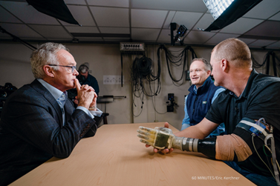
Enabling Sensation to Touch via Prosthetic Limbs
First-in-human trials neuroprosthetic system to improve hand function
Sensors in prosthetic hand activate implanted nerve cuff electrodes
Provide natural perceptions; foot system for balance and gait now being tested
Lead: D. Tyler, Louis Stokes/Cleveland VA https://www.aptcenter.research.va.gov/staff/investigators/tyler/
Dr. Dustin Tyler featured on CBS News’ 60 Minutes
Notes:
IN an exciting study coming from the Advanced Platform Technology Center (APTC) – Cleveland , Dr. Dustin Tyler is…..”Enabling Sensation to Touch via Prosthetic Limbs”
Neuroprosthetics, also known as brain-computer interfaces work by creating a connection between the brain and a computer. It does require surgical impanation of small neural sensor connecting to the nerve. This enables neural prostheses and assistive devices to move, hear, see and touch using the power of thought alone.
Next steps:
Research at the center is also looking at perception of natural touch for lower limb/foot .
Another line of neural interface research may include not prosthetic at all. Specifically, investigators are helping Veterans with SCI; in this case the brain impulses are routed through a computer to implants that are in an individual’s own arm. These muscles fire - stimulating movement.
This research is still in the clinical trial phase, but how Neurally Integrated Prosthesis are developed with the Veteran’s unique preferences and goals is a space for occupational therapy to contribute, especially how these technologies could be enhanced to consider future Home and Community Use.

Slide 9
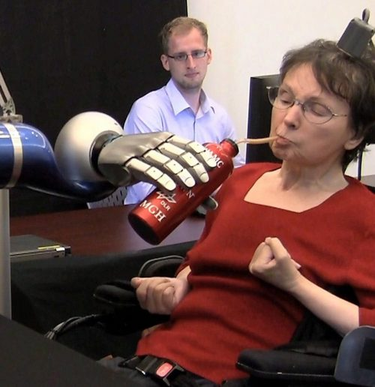
Restoring Communication & Mobility via Brain-Computer Interface
Translates brain activity into commands for assistive devices
Communication: enables onscreen typing, mouse control and speech synthesis
Mobility: harness brain activity associated with movement to command reach and grasp
Lead: L. Hochberg, J. Simeral, Providence VA
Brain-Computer Interface (BCI) BrainGate System
Notes:
Center for Neurorestoration & Neurotechnology (CfNN) out of the Providence VA, is Directed by Drs. Hochberg, and Greenberg, and seeks to translate neuotechnology to restore lost function.
The BrainGate System is neural interface system that could help retore independence of people with paralysis; For example, clinical trial participants with paralysis are able to control assistive devices just by thinking about the action they want to initiate. While this is still in the trial stage, this technology hold promise for restoring communication mobility and independence for Veterans with tetraplegia, ALS, etc.
Communication: Individuals with paralysis or loss of speech
To restore communication by translating brain activity directly into commands
for assistive devices to enable computer interaction, onscreen typing, and speech synthesis
Mobility: Recovering functional arm movement and/or grasping is a high priority for individuals with tetraplegia.
To enable those with paralysis to harness brain activity associated with attempted movements
To directly command reach and grasp movements of assistive robotics, advanced prosthetic arms, or even their own paralyzed arm and hand
(Leads L. Hochberg, J. Simeral, Providence VA)
https://www.brown.edu/news/2023-01-13/braingate-safety
RESEARCH STREAMS
Restoring Communication & Mobility to Improve Independence & Interactions via
Brain-Computer Interface (BCI) BrainGate System
Communication: Individuals with paralysis or loss of speech
To restore communication by translating brain activity directly into commands for assistive devices to enable computer interaction, onscreen typing, and speech synthesis
Text from thoughts could give patients (e.g., ALS) a voice
Leads L. Hochberg, J. Simeral
https://centerforneuro.org/communication-and-mobility/
Text from thoughts could give Veterans (e.g., ALS, SCI) a voice
Recovering functional arm movement and/or grasping is a high priority for individuals with tetraplegia. The BrainGate neural interface is being developed to enable Veterans and others with paralysis to harness the brain activity associated with attempted movements to directly command reach and grasp movements of assistive robotics, advanced prosthetic arms, or even their own paralyzed arm and hand. Investigators: Leigh Hochberg, MD, PhD and John Simeral, PhD
harness the brain activity associated with attempted movements to directly command reach and grasp movements of assistive robotics, advanced prosthetic arms, or even their own paralyzed arm and hand.
Dr. David Borton leads work devoted to improving function for persons with SCI. The Intellident Spince Interface clinical trial aimsed at restormg limb motion, sensation and bladder control in Veterans who suffered SCI. The proejt is working to deisn a brain spine interface that canhelp to response walkin in people with lower limb pr;
Project includes OT collaborators

Slide 10
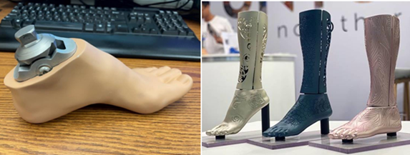
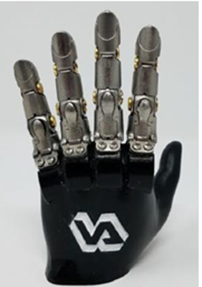
Addressing Prosthetic Needs of Women Veterans
3D Ankle-foot system with interchangeable feet help maintain alignment; commercial partner UNYK
Ability to wear shoes of various heel heights, types, including sandals
Lead: A. Hansen, Minneapolis VA
Artificial digit replacements appropriately sized for women; commercial partner Point Digit
Unpowered ratcheting 3D-printed steel finger; Simple, durable, anatomical motion
Lead: R Weir, Rocky Mtn VA
Prosthesis for improved footwear options
Point Digit Prosthesis
Notes:
Work conducted at the Rehabilitation & Engineering Center for Optimizing Veteran Engagement & Reintegration (RECOVER), Minneapolis VA, developed a new ankle-foot prosthesis system that will allow Veterans with amputations to choose any footwear with heel heights up to 4 inches, and to be able to easily switch between these footwear without needing to change the alignment of their prosthesis. This option will be useful for both men and women to more fully integrate into their lives after amputation (e.g. different heel heights for sports and other activities). This work was celebrated at the 2023 White House Demo Day, which showcase innovations in science. This event was attended by congressional staff and President Biden.
Artificial Digit Replacements Sized for Women Veterans with Individual Digit Loss
The Point Digit is a heavy-duty, passive articulating prosthetic finger designed to be both lightweight and strong, using a novel ratcheting mechanism to lock into 11 unique positions of flexion. This technology provides an effective and durable solution for many upper limb amputees with finger loss and ensure their ability to enjoy their work, family, and life to the fullest.
Nearly 2 million Americans living with limb loss (Ziegler-Graham et al, 2008),. The vast majority of prosthetic feet are aligned for a specific heel height shoe, with a potentially de-stabilizing effect on gait if the user decides to wear footwear with different heel heights

Slide 11
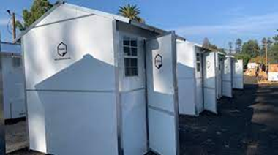
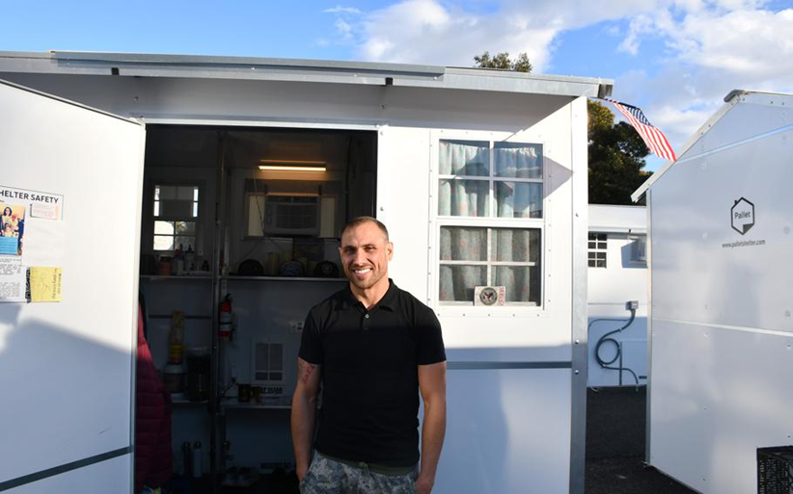
Ending Veteran Homelessness
Help beyond housing recognizes housing is first step in facilitating recovery
Social isolation does not subside once housed:
Understanding the determinants and mechanisms of community integration
Considering the contextual, social, and environmental factors that influence community integration
Developing and validating interventions that enhance community integration for these individuals
Notes:
So far, my research examples mainly illustrated engineering and prosthetic advancements, but I recognize that rehabilitation research is so much larger than this, as is the space that occupational therapy can contribute. For example, occupational therapists have been included in behavioral health and vocational r/social reintegration in VA homeless programs since 2008. OTs have unique perspectives and skills to support these individuals.
We know that people experiencing homelessness:
Have higher rates of mental health, traumatic brain injury, and substance use disorders than the general population (Stubbs et al., 2019).
Have higher rates of geriatric and physical health conditions 20–30 years earlier than their housed counterparts (Fazel et al., 2014). In fact, a recent VA study of more than 88,000 Veterans showed those experiencing housing instability were 53% more likely to have Alzheimer’s disease or related dementia diagnosis
To address these challenges, the THRIVe Center (Toward Homeless Recovery and Integration in Veterans), in LA fills a critical gap --the neglected problem of community integration for Veterans after housing has been attained. This Center is led by Dr. Michael Green.
Read more at: https://www.stripes.com/veterans/2022-03-14/veterans-affairs-homeless-los-angeles-tiny-shelters-funding-5341053.html?utm
Source - Stars and Stripes
https://www.stripes.com/veterans/2022-03-14/veterans-affairs-homeless-los-angeles-tiny-shelters-funding-5341053.html?utm
https://www.research.va.gov/currents/0222-Help-beyond-housing.cfm

